Slide 1
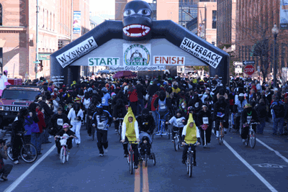
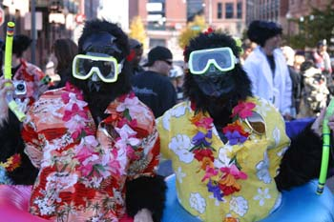
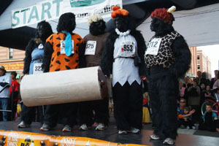

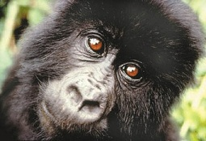
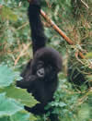
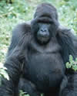
Volunteer Manual

Slide 2
Thank You!
Thank you so much for your willingness to help at the Denver Gorilla Run! Volunteers are an important part of our fundraising event and we couldn’t do it without you! We are happy to have you participate in this event and sincerely thank you for supporting our efforts to save the mountain gorillas of Africa.
The Denver Gorilla Run is a charity fun run with a difference. Everyone who takes part wears a full gorilla costume (included with entry fee…yours to keep!) and helps raise funds for the Mountain Gorilla Conservation Fund (MGCF).
MGCF is dedicated to the conservation and protection of the highly endangered Mountain Gorillas in Africa, their habitat, and working with the people around the National Parks. We have been doing this ever since Dian Fossey asked for help back in 1983.
In this manual, you will find information on MGCF’s history and projects. You will also find fundraising information. Yes, volunteers can fundraise too!
If you have any questions, feel free to contact us at 720-524-0272 or saveagorilla@yahoo.com.
Thanks for supporting our mission to save the world’s last remaining mountain gorillas,
- The MGCF Team

Slide 3
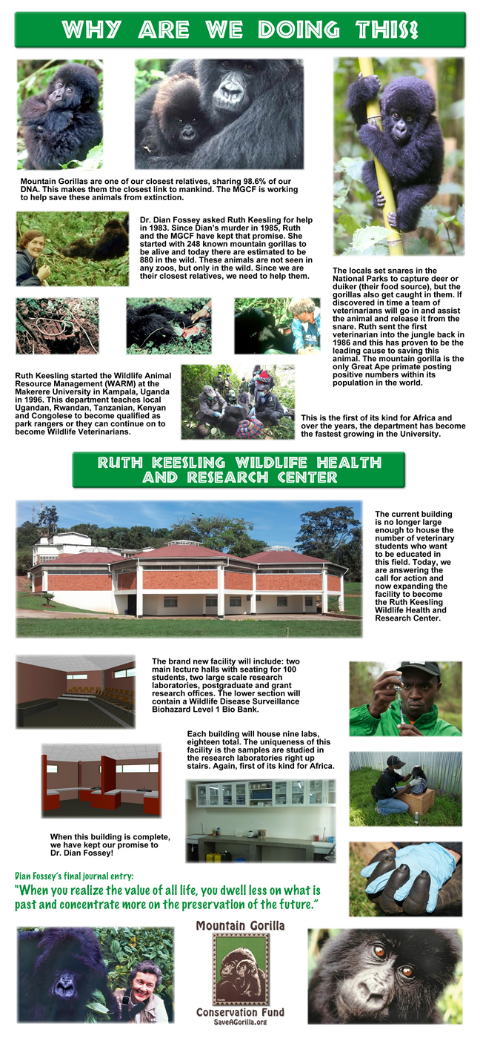

Slide 5
Fundraising Instructions
Online donations:
Visit https://secure.getmeregistered.com/get_information.php?event_id=10796.
Click the “Become a fundraiser” button.
Enter your fundraiser name (your name as an individual fundraiser or the team’s name for a group fundraising page) and contact information.
Personalize your fundraising page to include:
  Your fundraising goal
  Why you are participating in the Denver Gorilla Run
  Include any personal connection to the mountain gorillas
  Upload an image (gorilla picture, training in your gorilla suit, previous year pic)
Send your fundraising page link to all your friends and family! For your convenience, we’ve provided a pledge letter template.
On your fundraising page, use the social media icons to share with your networks and let them know about your fundraising efforts!
Remember you are eligible for great fundraising pledge incentives!
For additional help and support, email saveagorilla@yahoo.com.
Offline donations:
You can also collect cash donations or checks made payable to MGCF. Record fundraising dollars on the pledge form and drop off at the donations table on event day.

Slide 6
Pledge Letter to Send to Supporters
Hi There!
Remember the movie, "Gorillas In The Mist"? Well, I will be a volunteer at the 11th Annual Denver Gorilla Run on November 2nd. The Denver Gorilla Run is a charity fun run with a difference. Everyone who takes part wears a full gorilla costume (included with entry fee…yours to keep!) and helps raise funds for the Mountain Gorilla Conservation Fund (MGCF).
I am raising funds for MGCF and asking you to help by making a contribution. I’ve set a personal fundraising goal of $[INSERT GOAL]. Please visit [ADD PERSONAL FUNDRAISING PAGE WEBLINK HERE] to donate online quickly & securely. Or, why not participate in the event? Visit www.denvergorillarun.com to register today.
Why are we doing this?
MGCF needs to expand its veterinary program by educating local Ugandans and Rwandans to become veterinarians. The current facility at Makerere University has outgrown itself and we need more room to further the education of locals to first, protect the mountain gorilla, then expand to other wildlife in Uganda and Rwanda. MGCF needs support in raising funds to continue building the new expansion that will provide lecture halls, postgraduate and grant research offices, and a wildlife disease surveillance biohazard level 1 bank. MGCF was the first in the world to ever build an "on location" vet center in 1986 for the protection of endangered animals. Since then, 20 expatriate veterinarians have served in the countries and now locals have been educated enough to take over and protect their own wildlife. This is a great thing for central Africa!
I thank you in advance for your support and really appreciate your generosity!!
Denver Gorilla Run main web site: http://www.denvergorillarun.com
If you would like more information about the Mountain Gorilla Conservation Fund and how funds raised through the Denver Gorilla Run are used, please visit www.saveagorilla.org.
Please forward this email to as many people as you can and encourage them to donate!

Slide 7
Fundraiser Checklist
HAVE A PLAN AND STICK TO IT
The most effective way to achieve your fundraising goal is to create a detailed plan outlining the steps you'll need to complete in order to meet your objectives. Remember, sticking to your plan will ensure success!
Set a goal of at least $250.
Start early so you can give people ample time to donate.
Make it personal. Educate your donors on why this cause is so important to you.
Stress the benefits of contributing.
Ask BIG before going small.
Never feel guilty about asking for donations.
Keep track of who you’ve asked and follow-up.
Always ask contacts to forward your email to others.
Keep donors updated on your progress.
Ask, Ask, Ask!
Send thank you notes!
Don’t be afraid to ask everyone you know
Start by making your own contribution!
Friends, family members, and co-workers. You never know who is willing to contribute!
Ask your employer if they have a matching gift program or would be willing to make a corporate donation…have your donors ask their employers too!
Email local businesses that might be interested in your cause. Ask them to sponsor you.
Use social media
Update your Facebook status to let your friends know you are raising money for the mountain gorillas.
Tell your Twitter followers about your fundraising efforts.
Keep everyone up to date on progress towards your goal.
Set a Fundraising Goal
I will raise $ (we recommend $250.00) by November 2, 2014.
I will contact people in order to reach my goal.
Estimate the average contribution will be $50 and that 50% of the people you contact
will contribute. If you plan to raise $250, you only need to contact 10 people. Simple!

Slide 8
Pledge Form
Denver Gorilla Run November 2, 2014
Participant Name: ______________________ Team Name: _____________________
Address: _____________________________________________________________
City: _____________________________ State: ___________ Zip Code: _________
Phone Number: ________________________ E-mail: ________________________
Cash
Check
Sponsor’s Name | Address / City / State / Zip | Email | Amount Pledged
 |  |  |  | □ □
 |  |  |  | □ □
 |  |  |  | □ □
 |  |  |  | □ □
 |  |  |  | □ □
 |  |  |  | □ □
 |  |  |  | □ □
 |  |  |  | □ □
 |  |  |  | □ □
 |  |  |  | □ □
 |  |  |  | □ □
 |  |  |  | □ □
 |  |  |  | □ □
 |  | Total
  Please make checks payable to: MGCF
Bring this form to the Denver Gorilla Run on November 2, 2014
The donor’s name and address or email must be clearly printed and complete on the form above to receive a tax receipt from Mountain Gorilla Conservation Fund.

Slide 9
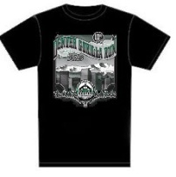

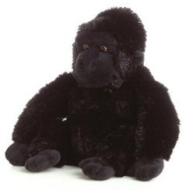
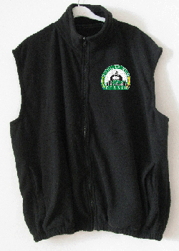
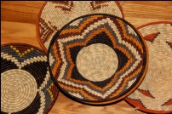
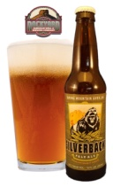
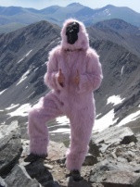
Pledge Incentives
Raise this amount | …to receive
$50 | Event T-shirt -or- Silverback Coffee of Rwanda (1 lb. bag)
$100 | Plush Gorilla -or- Fleece vest
$200 | Ugandan Basket or case of Silverback Pale Ale
$300 | A pink gorilla suit to distinguish you as one of our top fundraisers!
To claim this prize you must be over 21 and show proof of ID when picking up from the brewery.
Pledge incentive prizes are cumulative.
Raise $300 and you’ll receive a pink gorilla suit in addition to the Ugandan basket or beer, plush or vest, and event t-shirt or coffee.

